Slide 1
Project 2 Feature Selection with Nearest Neighbor
Due Date: Thursday of finals week at 11:59pm
Files are here
https://www.dropbox.com/sh/qis5nuvzwj8e4ip/AAB_0-VIywW68XomaRX91t70a?dl=0
Project2.doc
Project_2_sample_report.docx
Data_Key.csv
Your personalized small dataset
Your personalized large dataset
This presentation

Slide 2
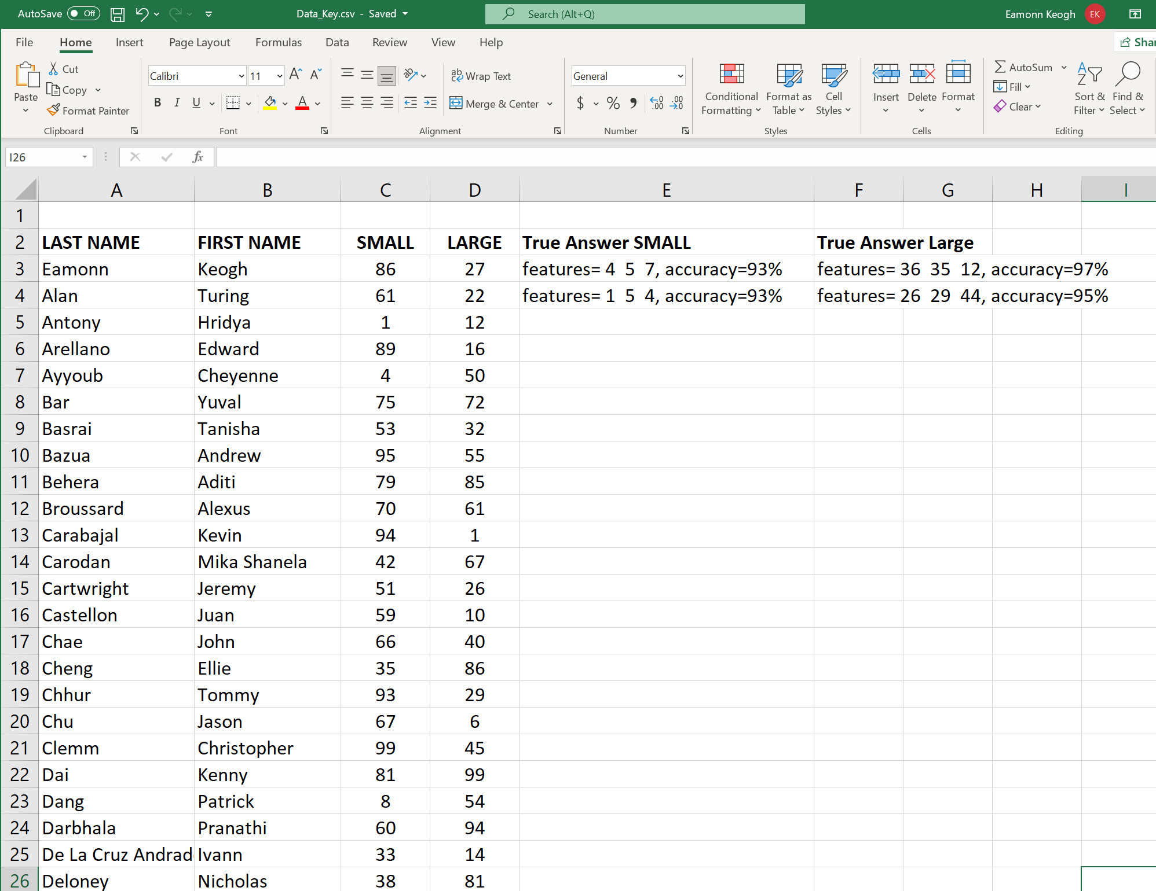

Slide 3
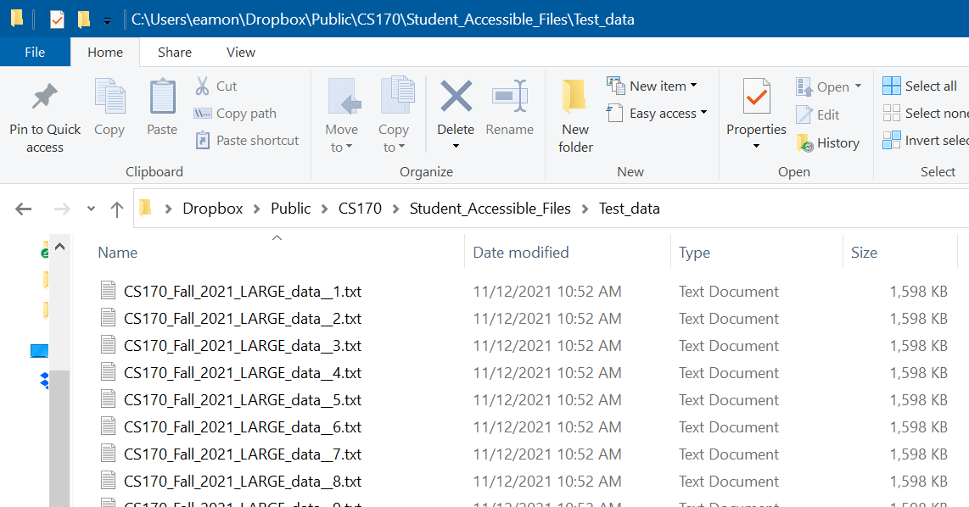

Slide 4
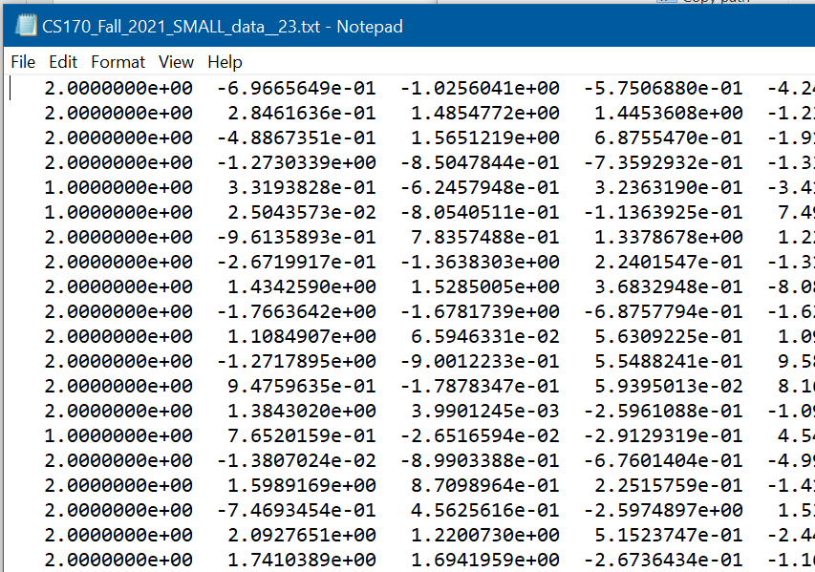

Slide 5

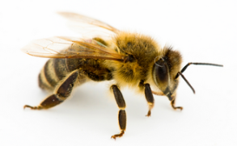
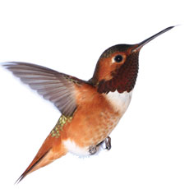
Feature Selection Classification Problem
The objects to be classified are flowers
The two classes are:
1) Was pollinated by a honey-bee
2) Was not pollinated by a honey-bee
The biologist measured four features:
F1: The longitude of the plant
F2: The latitude of the plant
F3: The height of the flower from ground
F4: The diameter of the flower.
Class F1 F2 F3 F4
0 1.4371 0.4416 0.8416 -0.6591
1 -0.0276 -0.8036 0.2391 0.7431
1 0.9239 0.2876 -0.7893 -0.1294
1 -0.3213 0.4670 1.0125 -0.7545
1 0.6611 0.0046 0.6234 0.2311
0 1.9153 0.3261 0.8232 0.9796

Slide 6
-3
-2
-1
0
1
2
3
This plot is F1
Class F1 F2 F3 F4
0 1.4371 0.4416 0.8416 -0.6591
1 -0.0276 -0.8036 0.2391 0.7431
1 0.9239 0.2876 -0.7893 -0.1294
1 -0.3213 0.4670 1.0125 -0.7545
1 0.6611 0.0046 0.6234 0.2311
0 1.9153 0.3261 0.8232 0.9796

Slide 7
4
3
2
1
0
-1
This plot is F1 vs F3
-2
-3
-4
-4
-3
-2
-1
0
1
2
3
4
Class F1 F2 F3 F4
0 1.4371 0.4416 0.8416 -0.6591
1 -0.0276 -0.8036 0.2391 0.7431
1 0.9239 0.2876 -0.7893 -0.1294
1 -0.3213 0.4670 1.0125 -0.7545
1 0.6611 0.0046 0.6234 0.2311
0 1.9153 0.3261 0.8232 0.9796

Slide 8
4
3
2
1
0
-1
-2
This plot is F3 vs F4
-3
-4
-3
-2
-1
0
1
2
3
4
Class F1 F2 F3 F4
0 1.4371 0.4416 0.8416 -0.6591
1 -0.0276 -0.8036 0.2391 0.7431
1 0.9239 0.2876 -0.7893 -0.1294
1 -0.3213 0.4670 1.0125 -0.7545
1 0.6611 0.0046 0.6234 0.2311
0 1.9153 0.3261 0.8232 0.9796

Slide 9
4
3
2
1
0
-1
This plot is F1 vs F2
-2
-3
-4
-4
-3
-2
-1
0
1
2
3
4
Class F1 F2 F3 F4
0 1.4371 0.4416 0.8416 -0.6591
1 -0.0276 -0.8036 0.2391 0.7431
1 0.9239 0.2876 -0.7893 -0.1294

Slide 10
Feature Selection Problem: You are given a problem with many features, but you are not told which features (if any) are useful for classification.
How can you figure out which are useful?
You could try plotting all pairs, and visual inspection, as in the previous slides.
For four features that is only 6 combinations
For fifty features there are 2⁵⁰ -1 =1,125,899,906,842,624
However, it might not be a pair of features that is best, it could be a subset of one, two, three…
Class F1 F2 F3 F4
0 1.4371 0.4416 0.8416 -0.6591
1 -0.0276 -0.8036 0.2391 0.7431
1 0.9239 0.2876 -0.7893 -0.1294
1 -0.3213 0.4670 1.0125 -0.7545
1 0.6611 0.0046 0.6234 0.2311
0 1.9153 0.3261 0.8232 0.9796

Slide 11
50%
1
2
3
4
1,2
1,3
2,3
1,4
2,4
3,4
1,2,3
1,2,4
1,3,4
2,3,4
1,2,3,4

Slide 12
1
2
3
4
62%
61%
51%
52%
1,2
1,3
2,3
1,4
2,4
3,4
1,2,3
1,2,4
1,3,4
2,3,4
1,2,3,4

Slide 13
1
2
3
4
97%
1,2
60%
1,3
2,3
58%
1,4
2,4
3,4
1,2,3
1,2,4
1,3,4
2,3,4
1,2,3,4

Slide 14
1
2
3
4
1,2
1,3
2,3
1,4
2,4
3,4
87%
1,2,3
88%
1,2,4
1,3,4
2,3,4
1,2,3,4

Slide 15
1
2
3
4
1,2
1,3
2,3
1,4
2,4
3,4
1,2,3
1,2,4
1,3,4
2,3,4
72%
1,2,3,4

Slide 16
The result of this search is that I now know:
1) Which subset of features is best for this problem.
2) My expected accuracy when I deploy this algorithm on this domain next week.
1
2
3
4
1,2
1,3
2,3
1,4
2,4
3,4
1,2,3
1,2,4
1,3,4
2,3,4
1,2,3,4
100
90
Class F1 F2 F3 F4
0 1.4371 0.4416 0.8416 -0.6591
1 -0.0276 -0.8036 0.2391 0.7431
1 0.9239 0.2876 -0.7893 -0.1294
1 -0.3213 0.4670 1.0125 -0.7545
1 0.6611 0.0046 0.6234 0.2311
0 1.9153 0.3261 0.8232 0.9796
80
70
60
50
40
No features
F1 and F2
F1 ,F2 and F4
All features
30
F1
20
10
0
0
1
2
3
4

Slide 17
For almost any problem we will see this basic curve.
A small number of features, 1 to 5, is best. After that, things begin to get worse.
1
2
3
4
5
6
7
8
1 0.5377 -1.3499 0.6715 0.8884 -0.1022 -0.8637 -1.0891 -0.6156 1.4193 -1.1480
0 1.8339 3.0349 -1.2075 -1.1471 -0.2414 0.0774 0.0326 0.7481 0.2916 0.1049
1 -2.2588 0.7254 0.7172 -1.0689 0.3192 -1.2141 0.5525 -0.1924 0.1978 0.7223
1 0.8622 -0.0631 1.6302 -0.8095 0.3129 -1.1135 1.1006 0.8886 1.5877 2.5855
0 0.3188 0.7147 0.4889 -2.9443 -0.8649 -0.0068 1.5442 -0.7648 -0.8045 -0.6669
0 -1.3077 -0.2050 1.0347 1.4384 -0.0301 1.5326 0.0859 -1.4023 0.6966 0.1873
1 -0.4336 -0.1241 0.7269 0.3252 -0.1649 -0.7697 -1.4916 -1.4224 0.8351 -0.0825
0 0.3426 1.4897 -0.3034 -0.7549 0.6277 0.3714 -0.7423 0.4882 -0.2437 -1.9330

Slide 18
Project II briefing
Feature Selection with Nearest Neighbor
I am going to give you lots of help, including writing some “guide code”
My “guide code” is MATLAB, which is very close to pseudocode.

Slide 19
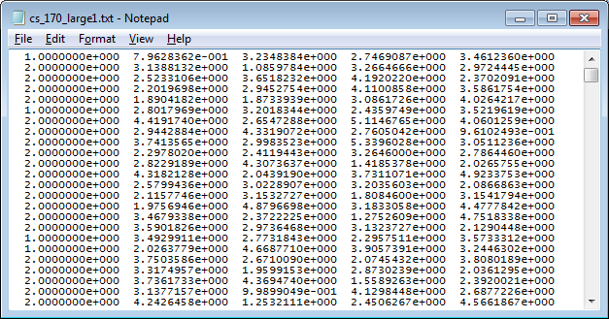
More generally the problem is: Given N features, how do you select the best subset?
For concreteness, in my examples, I will assume N = 4.
1
2
3
4
1,2
1,3
2,3
1,4
2,4
3,4
It might be that the problem is:
Lung_Cancer | Not_Lung_Cancer
And the features are
Height
Years working in coal mine
Weight
Cigarettes per day
To be clear, you will just see files like the one on the right..
1,2,3
1,2,4
1,3,4
2,3,4
1,2,3,4

Slide 20
More generally the problem is: Given N features, how do you select the best subset?
For concreteness, in my examples, I will assume N = 4.
1
2
3
4
1,2
1,3
2,3
1,4
2,4
3,4
1,2,3
1,2,4
1,3,4
2,3,4
1
2
3
4
1,2,3,4
1,2
1,3
2,3
1,4
2,4
3,4
100
80
1,2,3
1,2,4
1,3,4
2,3,4
60
40
1,2,3,4
20
0
{}
{4}
{4,2}
{4,2,1}
{4,2,1,3}

Slide 21
EDU>> feature_search_demo(mydata)
On the 1th level of the search tree
--Considering adding the 1 feature
--Considering adding the 2 feature
--Considering adding the 3 feature
--Considering adding the 4 feature
On level 1 i added feature 4 to current set
On the 2th level of the search tree
--Considering adding the 1 feature
--Considering adding the 2 feature
--Considering adding the 3 feature
On level 2 i added feature 2 to current set
On the 3th level of the search tree
--Considering adding the 1 feature
--Considering adding the 3 feature
On level 3 i added feature 1 to current set
On the 4th level of the search tree
--Considering adding the 3 feature
On level 4 i added feature 3 to current set
This is what project 2 search “looks” like.
I just want the printout, the figure is for your ref only.
(I should have printed out the accuracy at each step, below you will see why I did not do that here)
1
2
3
4
1,2
1,3
2,3
1,4
2,4
3,4
1,2,3
1,2,4
1,3,4
2,3,4
1,2,3,4

Slide 22
To finish this project, I recommend that you completely divorce the search part, from the cross-validation part.
To do this, I wrote a stub function that just returns a random number
I will use this in my search algorithm, and only when I am 100% sure that search works, will I “fill in” the full leave-one-out-cross-validation code.
function accuracy= leave_one_out_cross_validation(data,current_set,feature_to_add)
accuracy = rand; % This is a testing stub only
end

Slide 23
function feature_search_demo(data)
for i = 1 : size(data,2)-1
disp(['On the ',num2str(i),'th level of the search tree'])
end
end
I began by creating a for loop that can “walk” down the search tree.
I carefully tested it…
1
2
3
4
EDU>> feature_search_demo(mydata)
On the 1th level of the search tree
On the 2th level of the search tree
On the 3th level of the search tree
On the 4th level of the search tree
1,2
1,3
2,3
1,4
2,4
3,4
1,2,3
1,2,4
1,3,4
2,3,4
1,2,3,4

Slide 24
function feature_search_demo(data)
for i = 1 : size(data,2)-1
disp(['On the ',num2str(i),'th level of the search tree'])
for k = 1 : size(data,2)-1
disp(['--Considering adding the ', num2str(k),' feature'])
end
end
end
EDU>> feature_search_demo(mydata)
On the 1th level of the search tree
--Considering adding the 1 feature
--Considering adding the 2 feature
--Considering adding the 3 feature
--Considering adding the 4 feature
On the 2th level of the search tree
--Considering adding the 1 feature
--Considering adding the 2 feature
--Considering adding the 3 feature
--Considering adding the 4 feature
On the 3th level of the search tree
--Considering adding the 1 feature
--Considering adding the 2 feature
--Considering adding the 3 feature
--Considering adding the 4 feature
On the 4th level of the search tree
--Considering adding the 1 feature
--Considering adding the 2 feature
--Considering adding the 3 feature
--Considering adding the 4 feature
Now, inside the loop that “walks” down the search tree, I created a loop that considers each feature separately…
I carefully tested it…
1
2
3
4

Slide 25
function feature_search_demo(data)
for i = 1 : size(data,2)-1
disp(['On the ',num2str(i),'th level of the search tree'])
for k = 1 : size(data,2)-1
disp(['--Considering adding the ', num2str(k),' feature'])
end
end
end
We are making great progress!
These nested loops are basically all we need to traverse the search space.
However at this point we are not measuring the accuracy of leave_one_out_cross_validation and recording it, so lets us do that (next slide).

Slide 26
The code below almost works, but, once you add a feature, you should not add it again…
feature_search_demo(mydata)
On the 1th level of the search tree
--Considering adding the 1 feature
--Considering adding the 2 feature
--Considering adding the 3 feature
--Considering adding the 4 feature
On level 1 i added feature 2 to current set
On the 2th level of the search tree
--Considering adding the 1 feature
--Considering adding the 2 feature
--Considering…
function feature_search_demo(data)
current_set_of_features = []; % Initialize an empty set
for i = 1 : size(data,2)-1
disp(['On the ',num2str(i),'th level of the search tree'])
feature_to_add_at_this_level = [];
best_so_far_accuracy = 0;
for k = 1 : size(data,2)-1
disp(['--Considering adding the ', num2str(k),' feature'])
accuracy = leave_one_out_cross_validation(data,current_set_of_features,k+1);
if accuracy > best_so_far_accuracy
best_so_far_accuracy = accuracy;
feature_to_add_at_this_level = k;
end
end
disp(['On level ', num2str(i),' i added feature ', num2str(feature_to_add_at_this_level), ' to current set'])
end
end
We need an IF statement in the inner loop that says “only consider adding this feature, if it was not already added” (next slide)
1
2
3
4
1,2
2,3
2,4

Slide 27
…We need an IF statement in the inner loop that says “only consider adding this feature, if it was not already added”
EDU>> feature_search_demo(mydata)
On the 1th level of the search tree
--Considering adding the 1 feature
--Considering adding the 2 feature
--Considering adding the 3 feature
--Considering adding the 4 feature
On level 1 i added feature 4 to current set
On the 2th level of the search tree
--Considering adding the 1 feature
--Considering adding the 2 feature
--Considering adding the 3 feature
On level 2 i added feature 2 to current set
On the 3th level of the search tree
--Considering adding the 1 feature
--Considering adding the 3 feature
On level 3 i added feature 1 to current set
On the 4th level of the search tree
--Considering adding the 3 feature
On level 4 i added feature 3 to current set
function feature_search_demo(data)
current_set_of_features = []; % Initialize an empty set
for i = 1 : size(data,2)-1
disp(['On the ',num2str(i),'th level of the search tree'])
feature_to_add_at_this_level = [];
best_so_far_accuracy = 0;
for k = 1 : size(data,2)-1
if isempty(intersect(current_set_of_features,k)) % Only consider adding, if not already added.
disp(['--Considering adding the ', num2str(k),' feature'])
accuracy = leave_one_out_cross_validation(data,current_set_of_features,k+1);
if accuracy > best_so_far_accuracy
best_so_far_accuracy = accuracy;
feature_to_add_at_this_level = k;
end
end
end
current_set_of_features(i) = feature_to_add_at_this_level;
disp(['On level ', num2str(i),' i added feature ', num2str(feature_to_add_at_this_level), ' to current set'])
end
end

Slide 28
EDU>> feature_search_demo(mydata)
On the 1th level of the search tree
--Considering adding the 1 feature
--Considering adding the 2 feature
--Considering adding the 3 feature
--Considering adding the 4 feature
On level 1 i added feature 4 to current set
On the 2th level of the search tree
--Considering adding the 1 feature
--Considering adding the 2 feature
--Considering adding the 3 feature
On level 2 i added feature 2 to current set
On the 3th level of the search tree
--Considering adding the 1 feature
--Considering adding the 3 feature
On level 3 i added feature 1 to current set
On the 4th level of the search tree
--Considering adding the 3 feature
On level 4 i added feature 3 to current set
We are done with the search!
The code is the previous slide is all you need.
You just have to replace the stub function leave_one_out_cross_validation with a real function, and echo the numbers it returned to the screen.
1
2
3
4
1,2
1,3
2,3
1,4
2,4
3,4
1,2,3
1,2,4
1,3,4
2,3,4
1,2,3,4

Slide 29
These numbers are in standard IEEE 754-1985, single precision format (space delimited)
You can use an off-the-shelf package to read them into your program.

Slide 30
Part 2

Slide 31
What are we doing at each node?
We are running k-fold cross validation
This is a special case, where k is the number of objects in our dataset
(also called leave-one-out)
Depending on the node, we will be using various subsets of the features.
However, let us start by using all the features. I will write Matlab guide code..
1
2
3
4
1,2
1,3
2,3
1,4
2,4
3,4
1,2,3
1,2,4
1,3,4
2,3,4
1,2,3,4

Slide 32
Predictive Accuracy I
How do we estimate the accuracy of our classifier?
We can use K-fold cross validation
We divide the dataset into K equal sized sections. The algorithm is tested K times, each time leaving out one of the K section from building the classifier, but using it to test the classifier instead
Number of correct classifications
Number of instances in our database
Accuracy =
K = 5
Insect ID | Abdomen Length | Antennae Length | Insect Class
1 | 2.7 | 5.5 | Grasshopper
2 | 8.0 | 9.1 | Katydid
3 | 0.9 | 4.7 | Grasshopper
4 | 1.1 | 3.1 | Grasshopper
5 | 5.4 | 8.5 | Katydid
6 | 2.9 | 1.9 | Grasshopper
7 | 6.1 | 6.6 | Katydid
8 | 0.5 | 1.0 | Grasshopper
9 | 8.3 | 6.6 | Katydid
10 | 8.1 | 4.7 | Katydids

Slide 33
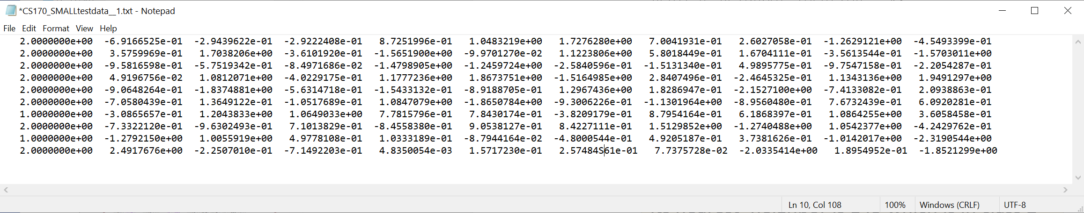
I am going to test on this smaller dataset…
C:\Users\eamon\Documents\MATLAB\CS170_SMALLtestdata__1.txt
K = the number of rows (here 10)
K = 10
Insect ID | Abdomen Length | Antennae Length | Insect Class
1 | 2.7 | 5.5 | Grasshopper
2 | 8.0 | 9.1 | Katydid
3 | 0.9 | 4.7 | Grasshopper
4 | 1.1 | 3.1 | Grasshopper
5 | 5.4 | 8.5 | Katydid
6 | 2.9 | 1.9 | Grasshopper
7 | 6.1 | 6.6 | Katydid
8 | 0.5 | 1.0 | Grasshopper
9 | 8.3 | 6.6 | Katydid
10 | 8.1 | 4.7 | Katydids

Slide 34
function accuracy = cs170demo()
data = load('C:\Users\eamon\Documents\MATLAB\CS170_SMALLtestdata__1.txt’);
for i = 1 : size(data,1)
object_to_classify = data(i,2:end);
label_object_to_classify = data(i,1);
disp(['Looping over i, at the ',int2str(i),' location']);
disp(['The ',int2str(i),'th object is in class ',num2str(label_object_to_classify)]);
end
end
Looping over i, at the 1 location
The 1th object is in class 2
Looping over i, at the 2 location
The 2th object is in class 2
Looping over i, at the 3 location
The 3th object is in class 2
Looping over i, at the 4 location
The 4th object is in class 2
Looping over i, at the 5 location
The 5th object is in class 2
Looping over i, at the 6 location
The 6th object is in class 2
Looping over i, at the 7 location
The 7th object is in class 1
Looping over i, at the 8 location
The 8th object is in class 2
Looping over i, at the 9 location
The 9th object is in class 1
Looping over i, at the 10 location
The 10th object is in class 2

Slide 35
function accuracy = cs170demo()
data = load('C:\Users\eamon\Documents\MATLAB\CS170_SMALLtestdata__1.txt’);
for i = 1 : size(data,1)
object_to_classify = data(i,2:end);
label_object_to_classify = data(i,1);
nearest_neighbor_distance = inf;
nearest_neighbor_location = inf;
for k = 1 : size(data,1)
disp(['Ask if ',int2str(i),' is nearest neigbour with ', int2str(k)])
end
end
end
Ask if 1 is nearest neigbour with 1
Ask if 1 is nearest neigbour with 2
Ask if 1 is nearest neigbour with 3
Ask if 1 is nearest neigbour with 4
Ask if 1 is nearest neigbour with 5
Ask if 1 is nearest neigbour with 6
Ask if 1 is nearest neigbour with 7
Ask if 1 is nearest neigbour with 8
Ask if 1 is nearest neigbour with 9
Ask if 1 is nearest neigbour with 10
Ask if 2 is nearest neigbour with 1
Ask if 2 is nearest neigbour with 2
Ask if 2 is nearest neigbour with 3
Ask if 2 is nearest neigbour with 4
Ask if 2 is nearest neigbour with 5
Ask if 2 is nearest neigbour with 6
Ask if 2 is nearest neigbour with 7
Ask if 2 is nearest neigbour with 8
Ask if 2 is nearest neigbour with 9
Ask if 2 is nearest neigbour with 10
Ask if 3 is nearest neigbour with 1
Ask if 3 is nearest neigbour with 2
Ask if 3 is nearest neigbour with 3
:::

Slide 36
function accuracy = cs170demo()
data = load('C:\Users\eamon\Documents\MATLAB\CS170_SMALLtestdata__1.txt’);
for i = 1 : size(data,1)
object_to_classify = data(i,2:end);
label_object_to_classify = data(i,1);
nearest_neighbor_distance = inf;
nearest_neighbor_location = inf;
for k = 1 : size(data,1)
if k ~= i % don’t compare to yourself!!!
disp(['Ask if ',int2str(i),' is nearest neigbour with ', int2str(k)])
end
end
end
end
Ask if 1 is nearest neigbour with 2
Ask if 1 is nearest neigbour with 3
Ask if 1 is nearest neigbour with 4
Ask if 1 is nearest neigbour with 5
Ask if 1 is nearest neigbour with 6
Ask if 1 is nearest neigbour with 7
Ask if 1 is nearest neigbour with 8
Ask if 1 is nearest neigbour with 9
Ask if 1 is nearest neigbour with 10
Ask if 2 is nearest neigbour with 1
Ask if 2 is nearest neigbour with 3
Ask if 2 is nearest neigbour with 4
Ask if 2 is nearest neigbour with 5
Ask if 2 is nearest neigbour with 6
Ask if 2 is nearest neigbour with 7
Ask if 2 is nearest neigbour with 8
Ask if 2 is nearest neigbour with 9
Ask if 2 is nearest neigbour with 10
Ask if 3 is nearest neigbour with 1
Ask if 3 is nearest neigbour with 2
Ask if 3 is nearest neigbour with 4
:::

Slide 37
function accuracy = cs170demo()
data = load('C:\Users\eamon\Documents\MATLAB\CS170_SMALLtestdata__1.txt’);
for i = 1 : size(data,1)
object_to_classify = data(i,2:end);
label_object_to_classify = data(i,1);
nearest_neighbor_distance = inf;
nearest_neighbor_location = inf;
for k = 1 : size(data,1)
disp(['Ask if ',int2str(i),' is nearest neigbour with ', int2str(k)])
if k ~= i
distance = sqrt(sum((object_to_classify - data(k,2:end)).^2));
if distance < nearest_neighbor_distance
nearest_neighbor_distance = distance;
nearest_neighbor_location = k;
nearest_neighbor_label = data(nearest_neighbor_location,1);
end
end
end
end
end
10
9
8
7
6
5
4
3
2
1
1
2
3
4
5
6
7
8
9
10

Slide 38
function accuracy = cs170demo()
data = load('C:\Users\eamon\Documents\MATLAB\CS170_SMALLtestdata__1.txt’);
for i = 1 : size(data,1)
object_to_classify = data(i,2:end);
label_object_to_classify = data(i,1);
nearest_neighbor_distance = inf;
nearest_neighbor_location = inf;
for k = 1 : size(data,1)
if k ~= i
distance = sqrt(sum((object_to_classify - data(k,2:end)).^2));
if distance < nearest_neighbor_distance
nearest_neighbor_distance = distance;
nearest_neighbor_location = k;
nearest_neighbor_label = data(nearest_neighbor_location,1);
end
end
end
disp(['Object ', num2str(i), ' is class ', num2str(label_object_to_classify)]);
disp(['Its nearest_neighbor is ', num2str(nearest_neighbor_location), ' which is in class ', num2str( nearest_neighbor_label )]);
end
end
Object 1 is class 2
Its nearest_neighbor is 9 which is in class 1
Object 2 is class 2
Its nearest_neighbor is 9 which is in class 1
Object 3 is class 2
Its nearest_neighbor is 9 which is in class 1
Object 4 is class 2
Its nearest_neighbor is 7 which is in class 1
Object 5 is class 2
Its nearest_neighbor is 8 which is in class 2

Slide 39
function accuracy = cs170demo()
data = load('C:\Users\eamon\Documents\MATLAB\CS170_SMALLtestdata__1.txt’);
number_correctly_classfied = 0;
for i = 1 : size(data,1)
object_to_classify = data(i,2:end);
label_object_to_classify = data(i,1);
nearest_neighbor_distance = inf;
nearest_neighbor_location = inf;
for k = 1 : size(data,1)
if k ~= i
distance = sqrt(sum((object_to_classify - data(k,2:end)).^2));
if distance < nearest_neighbor_distance
nearest_neighbor_distance = distance;
nearest_neighbor_location = k;
nearest_neighbor_label = data(nearest_neighbor_location,1);
end
end
end
if label_object_to_classify == nearest_neighbor_label;
number_correctly_classfied = number_correctly_classfied + 1;
end
end
accuracy = number_correctly_classfied / size(data,1);
end
The code above is 90% of what you need!!!
This function returns 0.4000

Slide 40
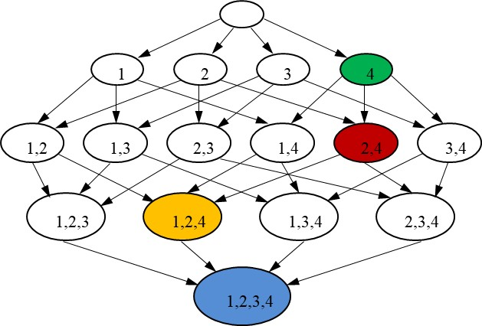
function accuracy= leave_one_out_cross_validation(data,current_set,feature_to_add)
number_correctly_classfied = 0;
for i = 1 : size(data,1)
object_to_classify = data(i,2:end);
label_object_to_classify = data(i,1);
nearest_neighbor_distance = inf;
nearest_neighbor_location = inf;
for k = 1 : size(data,1)
if k ~= i
distance = sqrt(sum((object_to_classify - data(k,2:end)).^2));
if distance < nearest_neighbor_distance
nearest_neighbor_distance = distance;
nearest_neighbor_location = k;
nearest_neighbor_label = data(nearest_neighbor_location,1);
end
end
end
if label_object_to_classify == nearest_neighbor_label;
number_correctly_classfied = number_correctly_classfied + 1;
end
end
accuracy = number_correctly_classfied / size(data,1);
end

Slide 41
1 4 7
10
function accuracy= leave_one_out_cross_validation(data,current_set,feature_to_add)
number_correctly_classfied = 0;
for i = 1 : size(data,1)
object_to_classify = data(i,2:end);
label_object_to_classify = data(i,1);
nearest_neighbor_distance = inf;
nearest_neighbor_location = inf;
for k = 1 : size(data,1)
if k ~= i
distance = sqrt(sum((object_to_classify - data(k,2:end)).^2));
if distance < nearest_neighbor_distance
nearest_neighbor_distance = distance;
nearest_neighbor_location = k;
nearest_neighbor_label = data(nearest_neighbor_location,1);
end
end
end
if label_object_to_classify == nearest_neighbor_label;
number_correctly_classfied = number_correctly_classfied + 1;
end
end
accuracy = number_correctly_classfied / size(data,1);
end
Some code to do this…

Slide 42
1, 4, 7
10
function accuracy= leave_one_out_cross_validation(data,current_set,feature_to_add)
number_correctly_classfied = 0;
for i = 1 : size(data,1)
object_to_classify = data(i,2:end);
label_object_to_classify = data(i,1);
nearest_neighbor_distance = inf;
nearest_neighbor_location = inf;
for k = 1 : size(data,1)
if k ~= i
distance = sqrt(sum((object_to_classify - data(k,2:end)).^2));
if distance < nearest_neighbor_distance
nearest_neighbor_distance = distance;
nearest_neighbor_location = k;
nearest_neighbor_label = data(nearest_neighbor_location,1);
end
end
end
if label_object_to_classify == nearest_neighbor_label;
number_correctly_classfied = number_correctly_classfied + 1;
end
end
accuracy = number_correctly_classfied / size(data,1);
end
Some code to do this…
0
0
0
0
0
0
0
0
0
0
0
0
0
0
0
0
0
0
0
0
0
0
0
0
0
0
0
0
0
0
0
0
0
0
0
0
0
0
0
0
0
0
0
0
0
0
0
0
0
0
0
0
0
0
0
0
0
0
0
0
Done!!!!

Slide 43
I have a key for all the datasets.
For example, I know that
On large dataset 27 the accuracy rate can be 0.97 when using only features 36, 35 and 12
In other words all the features are irrelevant, except for features 36, 35 and 12
And I know that if you use ONLY those features, you can get an accuracy of about 0.97
You don’t have this key! So it is your job to do the search to find that subset of features.
Everyone will have a different subset and a different achievable accuracy

